Slide 1
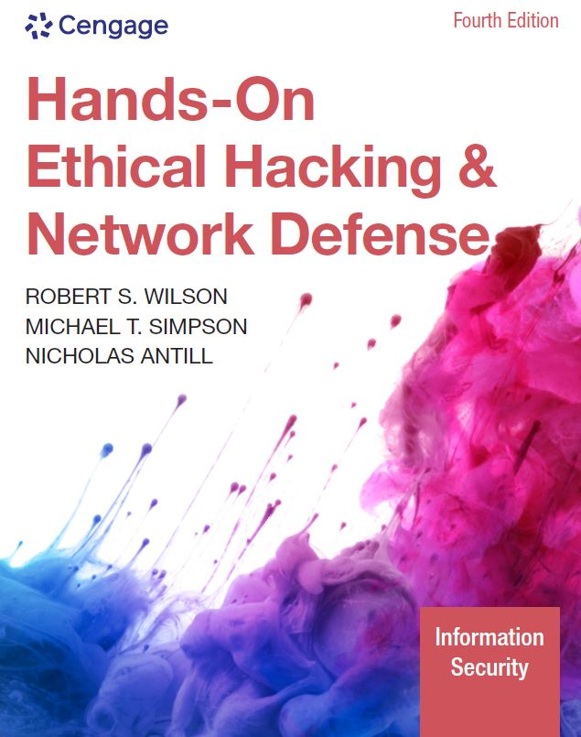
Hands-On Ethical Hacking and Network Defense,
Edition 4
Module 9: Embedded Operating Systems: The Hidden Threat
Simpson, Antill, Wilson, Hands-On Ethical Hacking and Network Defense, 4th Edition. © 2023 Cengage. All Rights Reserved. May not be scanned, copied or duplicated, or posted to a publicly accessible website, in whole or in part.

Slide 2
Module Objectives
By the end of this module, you should be able to:
  Explain what embedded operating systems are and where they’re used
  Describe the Internet of Things (IoT) and other embedded operating systems
  Identify vulnerabilities of embedded operating systems and best practices for protecting them

Slide 3
Introduction to Embedded Operating Systems (1 of 3)
Embedded system
  Any computer system that isn’t a general-purpose PC or server
    Found in GPS devices, ATMs, and in a wide array of electronic consumer and industrial items
Embedded operating system (OS)
  Small program developed specifically for use with embedded systems
  Stripped-down version of OS commonly used on general-purpose computers
    Designed to be small and efficient

Slide 4
Introduction to Embedded Operating Systems (2 of 3)
Real-time operating system (RTOS)
  Typically used in devices such as programmable thermostats, appliance controls, and spacecraft
Corporate buildings
  May have many embedded systems
    Firewalls, switches, routers, web-filtering appliances, network attached storage (NAS) devices, etc.
Embedded systems
  Are in all networks
  Perform essential functions
    Route network traffic
    Block suspicious packets

Slide 5
Introduction to Embedded Operating Systems (3 of 3)
Recently, security researchers reverse-engineered the software on a popular firewall’s chipset (firmware)
  They inserted modified software to control the firewall’s behavior
  Hackers who could do this could modify a firewall to copy network traffic passing through an interface
    Could give an external IP address full access through the firewall

Slide 6
Knowledge Check Activity 9-1
An embedded OS must be developed specifically for use with embedded systems. True or false?
True
False
Notes:
Instructions:
Use the Knowledge Check questions to periodically pose a question to students during class to gauge how well they can recall the material that was presented.

Slide 7
Knowledge Check Activity 9-1: Answer
An embedded OS must be developed specifically for use with embedded systems. True or false?
Answer: b. False
An embedded operating system can be a small program developed specifically for use with embedded systems, or it can be a stripped-down version of an OS commonly used on general-purpose computers.

Slide 8
Polling Activity 9-1
Which of the following describes an RTOS?
An embedded OS capable of multitasking and responding predictably
An embedded OS intended for real-time data manipulation
An embedded OS intended for packet analysis
An embedded OS intended for devices that run multiple OSs
Notes:
Instructions:
1. Use this activity to solicit student opinions about ethical hacking and related concepts in the module or to play a game.
2. Go to kahoot.com, or the platform of your preference, and log in or sign up.
3. Create the challenge.
4. Teacher Tip: Turn off the timer to prioritize accuracy or turn on the nickname generator to avoid inappropriate nicknames.
5. Invite players by sharing the link or PIN.
6. This can be done synchronously during class or asynchronously for review or homework.

Slide 9
Polling Activity 9-1: Answer
Which of the following describes an RTOS?
Answer: a. An embedded OS capable of multitasking and responding predictably
RTOS is designed with an algorithm aimed at multitasking and responding predictably.

Slide 10
Polling Activity 9-2
Which of the following does not use an embedded OS?
ATM
Workstation running Windows 10
NAS device running Windows Server 2012 for Embedded Systems
Slot machine
Notes:
Instructions:
1. Use this activity to solicit student opinions about ethical hacking and related concepts in the module or to play a game.
2. Go to kahoot.com, or the platform of your preference, and log in or sign up.
3. Create the challenge.
4. Teacher Tip: Turn off the timer to prioritize accuracy or turn on the nickname generator to avoid inappropriate nicknames.
5. Invite players by sharing the link or PIN.
6. This can be done synchronously during class or asynchronously for review or homework.

Slide 11
Polling Activity 9-2: Answer
Which of the following does not use an embedded OS?
Answer: b. Workstation running Windows 10
A workstation running Windows 10 uses a desktop PC that does not require an embedded operating system as it is running on a Windows OS.

Slide 12
Windows and Other Embedded Operating Systems (1 of 2)
Recycling common code and reusing technologies
  Sound software engineering practices
    However, they introduce common points of failure in many products
    Viruses, worms, Trojans, and other attack vectors take advantage of shared code
Windows and Linux vulnerabilities
  Might also exist in embedded version
Windows CE
  Trimmed-down version of the Windows desktop OS
    Much of the rest of it is available to hardware vendors, partners, and developers, based on their licensing level
  Some source code is available to the public
    Rare in 2022, but still worth knowing about

Slide 13
Windows and Other Embedded Operating Systems (2 of 2)
Windows 10 IoT
  Provides full Windows API
  Performs many of the same tasks as the personal computer (PC) version
    Does not have a PC interface
  Designed for use on commodity devices
    Example: Raspberry Pi
  Designed to make things easy for developers

Slide 14
Other Proprietary Embedded OSs (1 of 5)
VxWorks
  Widely used embedded real-time OS
    Developed by Wind River Systems
  Used in many different environments and applications
  Designed to run efficiently on minimal hardware
  Used by a variety of systems

Slide 15
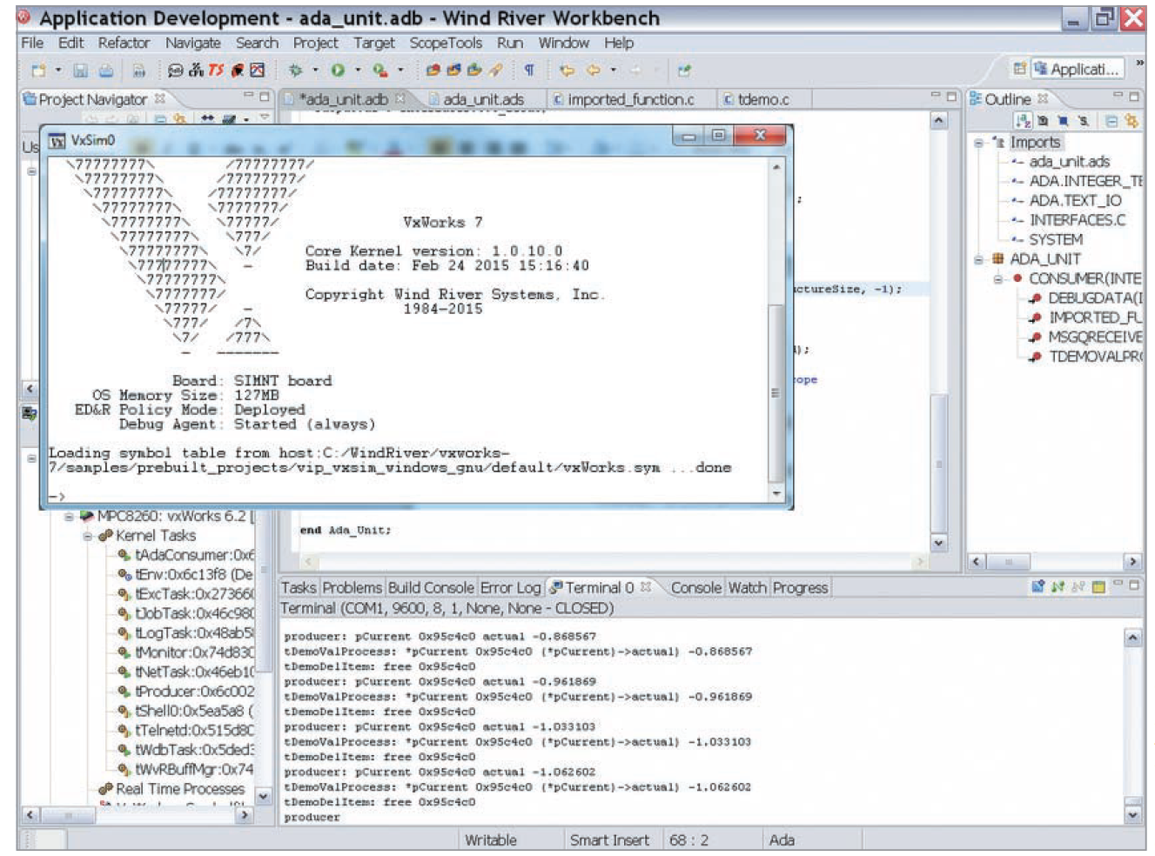
Other Proprietary Embedded OSs (2 of 5)
Source: Wind River Systems
Figure 9-1 Creating an embedded OS image in Wind River’s VxWorks Workbench

Slide 16
Other Proprietary Embedded OSs (3 of 5)
Green Hill Software produces a variety of embedded OSs
  F-35 Joint Strike Fighter
  Multiple independent levels of security/safety (MILS)
    Embedded OS certified to run multiple levels of classification
  Designs embedded OS code used in printers, routers, switches, etc.
QNX Software Systems QNX
  Commercial RTOS
  Used in Cisco’s ultrahigh-availability routers and Logitech universal remotes

Slide 17
Other Proprietary Embedded OSs (4 of 5)
Real-Time Executive for Multiprocessor Systems (RTEMS)
  An open-source embedded OS
  Used in space systems
    Support processors designed specifically to operate in space
Using multiple embedded OSs increases the attack surface
  NASA has improved Mars Reconnaissance Orbiter’s survivability by using several small embedded OSs tailored for specific functions

Slide 18
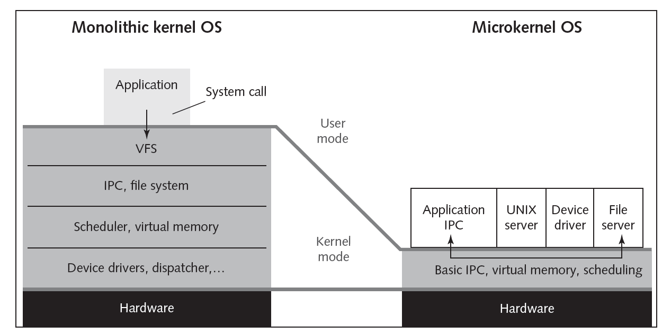
Other Proprietary Embedded OSs (5 of 5)
Figure 9-2 Monolithic kernel versus microkernel OSs

Slide 19
*Nix Embedded OSs (1 of 3)
Embedded Linux
  Example of a monolithic OS used in industrial, medical, and consumer items
  Embedded versions of Linux and other *nix OSs can be tailored for devices with limited memory or hard drive capacity
  Advantage of monolithic kernel
    Supports the widest variety of hardware
    Allows adding features by using dynamic kernel modules

Slide 20
*Nix Embedded OSs (2 of 3)
Wind River Linux
  Linux OS for embedded systems
  Produced by Wind River
  Linux variant RTOS suitable for embedded applications
    Requires a guaranteed response in a mathematically predictable manner
Linux dd-wrt
  Embedded Linux OS
  Initially designed for use on the Linksys WRT54G wireless router
  Can be run on most small office or home routers

Slide 21
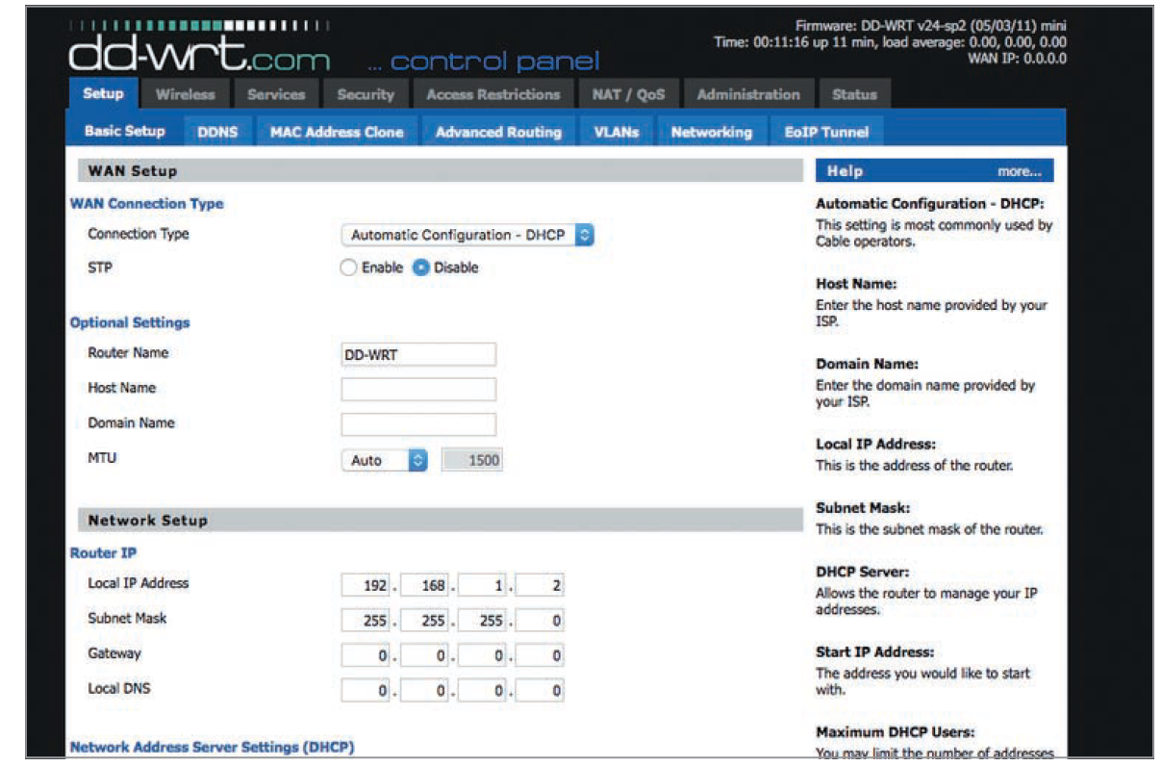
*Nix Embedded OSs (3 of 3)
Source: GNU Public License
Figure 9-3 Control panel for dd-wrt

Slide 22
Knowledge Check Activity 9-2
VxWorks is which of the following?
Windows embedded OS
Proprietary embedded OS
Linux embedded OS
Windows security validation tool
Notes:
Instructions:
Use the Knowledge Check questions to periodically pose a question to students during class to gauge how well they can recall the material that was presented.

Slide 23
Knowledge Check Activity 9-2: Answer
VxWorks is which of the following?
Answer: b. Proprietary embedded OS
VxWorks is a proprietary embedded real-time OS developed by Wind River Systems.

Slide 24
Vulnerabilities of Embedded OSs
Impact of attacks have become more serious
  Embedded OSs are no exception
Easiest way to profit from hacking
  Attack devices that store and dispense cash (e.g., ATMs)
  ATMs are vulnerable to attacks upon their software performed locally or remotely
    Physical attacks can also occur, which involve the use of card skimmers or even stealing the machines

Slide 25
Embedded OSs Are Everywhere
Embedded systems with Y2K software flaw were located everywhere
  Today, there are many more embedded devices to be concerned about than in 2000
    Are under attack from hackers and terrorists who want to further their financial or political causes
    Addressing security early in the design phase is essential

Slide 26
Embedded OSs Are Networked (1 of 2)
Advantages of connecting to a network
  Efficiency and economy
  Ability to manage systems and share services while keeping the amount of human resources and expertise is minimal
    Helps companies reduce costs
Gaining efficiency and reducing costs have a price
  Any device added to a network infrastructure increases the potential for security problems

Slide 27
Embedded OSs Are Networked (2 of 2)
Security testers should address questions such as the following:
  What Peripheral Component Interconnect (PCI) or USB devices are present?
  Where were they manufactured? Is the supply chain trustworthy?
  Which devices have embedded OSs stored in rewriteable (nonvolatile) memory? Rewriteable memory can be flashed
  Which embedded OS is currently loaded on each device?
  Can you make sure the embedded OS hasn’t been corrupted or subverted with malicious code?

Slide 28
Embedded OSs Are Difficult to Patch (1 of 2)
General-purpose desktop OSs
  Wait for vulnerability to be identified, then download, and install the patch when it’s available
  Restart the system, if necessary
  Patching is simple
Embedded OSs
  Must continue operating regardless of threats, particularly in critical systems
  Patching may be a problem
    System administrators may have no clue how to patch a web server running on a tiny chip
  Buffer overflow attacks might be successful
    Because few updates are released to correct vulnerabilities
    Manufacturers typically prefer system upgrades

Slide 29
Embedded OSs Are Difficult to Patch (2 of 2)
Open-source software
  Cost of developing and patching is shared by the entire open-source community
Patching Linux kernel
  Cost in programmer hours is estimated at tens of billions of dollars
Linux kernel offers flexibility and support for sophisticated features
  Large; has many code portions that might need to be patched
Fixing minor vulnerabilities that are expensive to fix in embedded OSs
  Programmer must weigh the cost of fixing the vulnerability against the importance of the information the embedded system controls

Slide 30
Embedded OSs Are in Networking Devices (1 of 2)
Networking devices usually have software and hardware designed to transmit information across networks
General-purpose computers originally performed routing and switching
  High-speed networks now use specialized hardware and embedded OSs
Attacks that compromise a router can give attackers the complete access to every host on the network
Attackers follow usual methods of footprinting, scanning, and enumerating the target to compromise an entire network

Slide 31
Embedded OSs Are in Networking Devices (2 of 2)
Authentication bypass vulnerability
  A common vulnerability of routers and other network devices with built-in web management interfaces
  Specially crafted URL bypasses the normal authentication mechanism
After bypassing authentication, attackers can launch other network attacks
  They use the access gained through compromising the router

Slide 32
Embedded OSs Are in Network Peripherals (1 of 3)
Common peripheral devices on an organization’s network:
  Include printers, scanners, copiers, and fax devices
Multifunction devices (MFDs)
  Perform more than one function
  Rarely scanned for vulnerabilities or configured for security
  Have embedded OSs with sensitive information
    Information may be susceptible to theft and modification
    Malware or malicious links can be inserted into the OSs
    Social-engineering techniques may be used by attackers to masquerade as support technicians
Printers should be reconfigured before connecting them to a network
  Most printers have only TCP/IP enabled, but unfortunately, default administrator usernames and passwords are still configured

Slide 33

Embedded OSs Are in Network Peripherals (2 of 3)
Source: bbc.com
Figure 9-4 PewDiePie Printer Hack Output

Slide 34
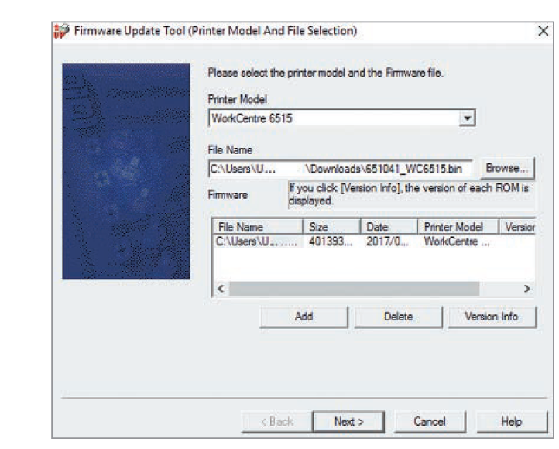
Embedded OSs Are in Network Peripherals (3 of 3)
Source: Xerox Corporation
Figure 9-5 Firmware file being uploaded to a networked printer

Slide 35
Supervisory Control and Data Acquisition Systems (SCADA) (1 of 2)
Used for equipment monitoring in large industries where automation is critical, such as public works and utilities
May have many embedded systems as components
  Components might be vulnerable through data fed in and out of them or through their embedded OSs
SCADA systems controlling critical infrastructure are usually separated from the Internet by an “air gap”

Slide 36
Supervisory Control and Data Acquisition Systems (SCADA) (2 of 2)
December 2015
  An attack on a Ukrainian power plant left about 700,000 people in the dark for a few hours
  Later, it was uncovered that a piece of malicious code named “Black-Energy” was introduced to infect systems at the power plant
    It is assumed that attackers interacted with a SCADA system to interrupt the flow of power

Slide 37
Cell Phones, Smartphones, and PDAs (1 of 2)
Conversations over traditional phones
  Considered protected
  Used to require a lot of time, expensive equipment, and a warrant
  Many have the same security expectations of cell phones, smartphones, and smartphones
Cell phone vulnerabilities include the following:
  Attackers listening to your phone calls
  Using the phone as a microphone
  “Cloning” the phone to make long-distance calls
  Get useful information for computer or network access
    Steal trade or national security secrets

Slide 38
Cell Phones, Smartphones, and PDAs (2 of 2)
Smartphones
  Security researchers and attackers have created Java-based viruses as well as code
    Can infect phones running Google Android, Windows Mobile, and the Apple iPhone OS (iOS)
    The line is blurring between embedded and general-purpose OSs
      These OSs have vulnerabilities that can compromise your smartphone’s security
    Wearable technologies increase the vulnerabilities of smartphone because of their interaction through Bluetooth
Trojan applications have become a big concern in mobile application stores
  Examples: Cake VPN, Pacific VPN, BeatPlayer, QR/Barcode Scanner MAX, and QRecorder

Slide 39
Rootkits (1 of 3)
Modify parts of OS or install themselves as kernel modules, drivers, libraries, and applications
  Exist for Windows and *nix OSs
Rootkit-detection tools and antivirus software
  Detect rootkits and prevent installation
    More difficult if OS has already been compromised
    Rootkits can monitor the OS for anti-rootkit tools and neutralize them
Biggest threat
  Rootkits that infect a device’s firmware
  More dangerous because they tend to be extremely small
    Loaded in low-level nonvolatile storage that anti-rootkit tools can’t access readily
    Can persist even after the hard drive has been reformatted

Slide 40
Rootkits (2 of 3)
Trusted Platform Module (TPM)
  A cryptographic firmware bootcheck processor installed on many recent computer systems
  Acts as a defense against low-level rootkits
    Ensures that OS hasn’t been subverted or corrupted
  ISO standard ISO/IEC 11889
Firmware rootkits
  Hard to detect as the code for firmware often isn’t checked for possible corruption
Insider hacking
  Harder to detect with malicious code hidden in flash memory of their company computers before they leave the company

Slide 41
Rootkits (3 of 3)
Systems that are compromised even before purchase
  May function like normal
  Must flash (rewrite) the BIOS with a known clean copy, wipe the hard drive, and reload the OS from clean installation media
    Expensive and time-consuming
LoJack for Laptops
  Popular laptop theft-recovery service
  Has some design-level vulnerabilities that rootkits can exploit
    Infection resides in the computer’s BIOS
      Persists even after the OS is reinstalled or the hard drive is replaced
    Call-home mechanism
      Allows the monitoring authority to instruct the LoJack BIOS agent to wipe all information as a security measure or to track the stolen system’s location.

Slide 42
Best Practices for Protecting Embedded OSs (1 of 2)
Identify all embedded systems in an organization
Prioritize the systems or functions that depend on embedded systems
Follow least privileges principle for access to embedded systems
Use data transport encryption
Configure embedded systems securely
  Follow manufacturers’ recommendations

Slide 43
Best Practices for Protecting Embedded OSs (2 of 2)
Use cryptographic measures for booting embedded systems
Install patches and updates
Restrict network access to only the IP addresses that need to communicate with embedded systems
  And reduce attack surface by disabling or blocking unneeded services
Upgrade or replace embedded systems that can’t be fixed or pose unacceptable risks

Slide 44
Discussion Activity 9-1
Discuss as a group why rootkits that infect a device’s firmware are considered the biggest threat to any OS (embedded or general-purpose).
Notes:
Instructions:
Use the Discussion activity to encourage group conversation about a related topic of interest.

Slide 45
Discussion Activity 9-1: Answer
Discuss as a group why rootkits that infect a device’s firmware are considered the biggest threat to any OS (embedded or general-purpose).
Answer: Rootkits tend to be extremely small, are loaded in low-level nonvolatile storage that anti-rootkit tools can’t access readily, and can persist even after the hard drive has been reformatted.

Slide 46
Self-Assessment
Explain why embedded device security is important.
Recall the different kinds of embedded OSs.
Notes:
Instructions:
Use the Self-Assessment question to encourage students to evaluate their progress or goals in the course, as well as determine how they might apply their learning or grow as an individual.

Slide 47
Summary
Now that the lesson has ended, you should be able to:
  Explain what embedded operating systems are and where they’re used
  Describe the Internet of Things (IoT) and other embedded operating systems
  Identify vulnerabilities of embedded operating systems and best practices for protecting them

